Slide 1
Micro credit loan use case
By Utsav Rastogi

Slide 2
Problem Statement
A Micro Financial Institution (MFIs) enable low income population to receive Micro loans which can help them in their hour of need.
They have partnered with a telecom company to bring Mobile Financial service (MFS) as it has more reach, is efficient and convenient for both parties.
We have to develop a model for a MFI that can detect whether a loan would be paid back within 5 days by the customer of their client, which is a telecom company in Indonesia.

Slide 3
Process
MFI
Telecom Company
Customer
Provides lending Facility to the company
Offers microloans to customers for recharging their main and data accounts in emergency.
Customer needs to return the loan in 5 days to the credit lending facility through the telecom company.

Slide 4
Data Pipeline
Initial Data Analysis
Data cleaning
Exploratory Data Analysis
Statistical analysis
Feature Engineering
Feature Selection
Splitting Data
Modeling
Balancing classes
Saving the model

Slide 5
Modeling
Testing of Identified Approaches (Algorithms)
Algorithms used:
Logistic Regression
Decision Tree Classifier
Random Forest Classifier
Gradient Boosting Classifier

Slide 6
Models
Accuracy Score
Cross Validation Score
Model | Score
Decision Tree | 83.40962539895851
Random Forest | 90.21501763816563
Logistic Regression | 76.12758273139593
Gradient Boosting Classifier | 87.05274651436251
Model | Score
Decision Tree | 91.22763732571812
Random Forest | 91.44286494204603
Logistic Regression | 87.85853771207795
Gradient Boosting Classifier | 91.39666974634638

Slide 7
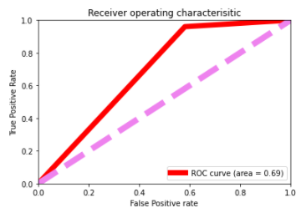
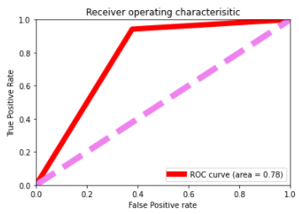
Another Important Metric
ROC Curve area
The Area Under the Curve (AUC) is the estimate of the potential of any classifier to differentiate between classes and is used as a summary of the ROC curve statistics.
The greater the AUC, the better the performance of the model at differentiating between the binary classes.
Decision Tree Classifier
Area=0.69
Random Forest Classifier
Area=0.78

Slide 8
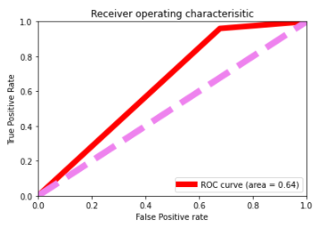
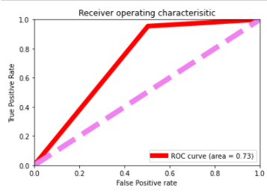
Continued.
Gradient Boosting Classifier
Area = 0.73
Logistic Regression
Area = 0.64

Slide 9
Model Benefits
It will help the company understand the parameters which is encouraging customers to not default.
Model can be deployed on large scale with some improvements , to help maximize the revenue for the company in terms of reducing defaulters.
Aid the marketing team in framing their marketing strategies towards future non defaulters, and hence keep the company’s loan revenue positive.
Help understand which customers might default, which could later be charged a higher interest rate.

Slide 10
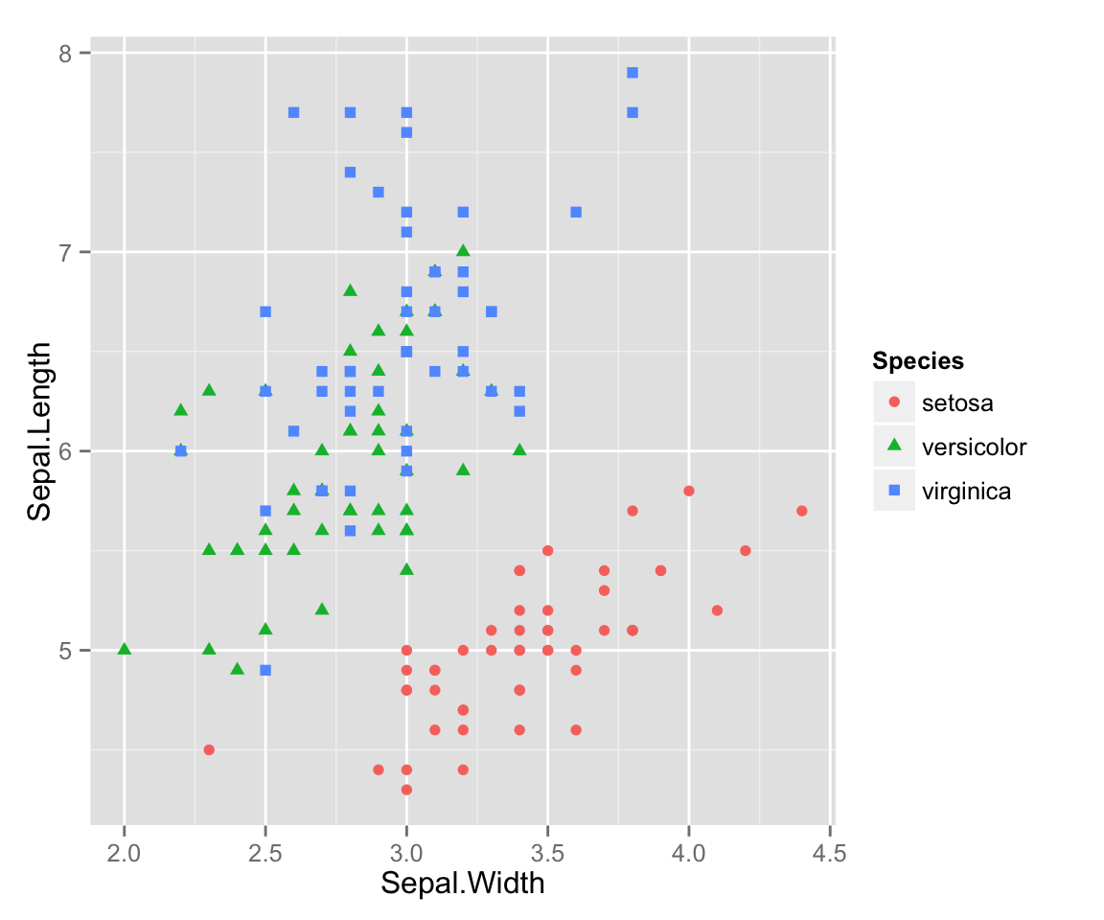
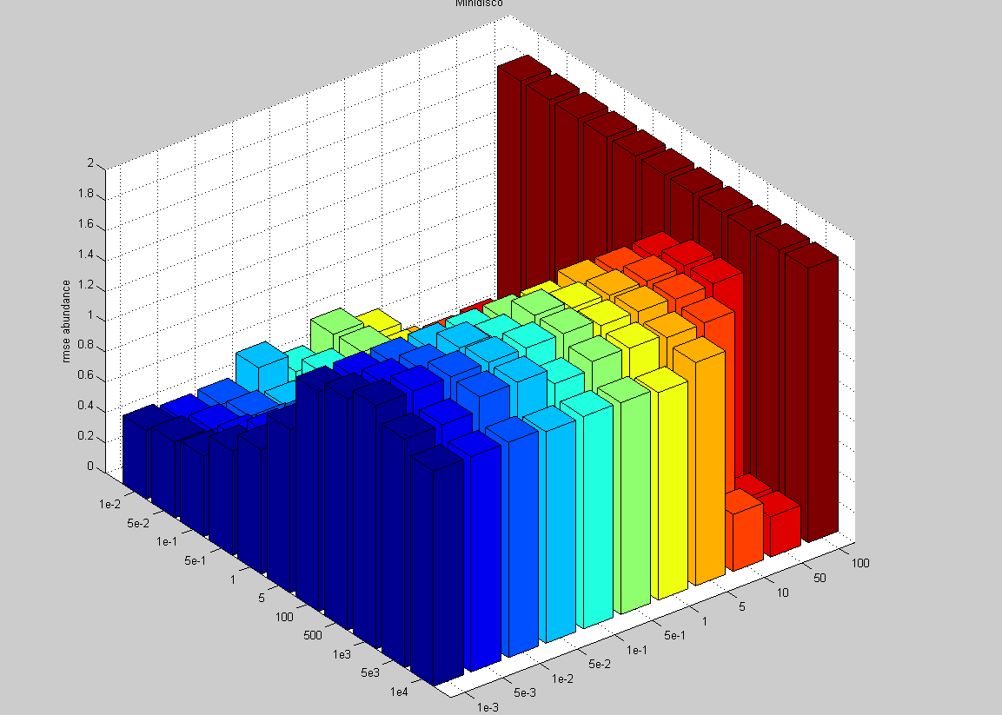
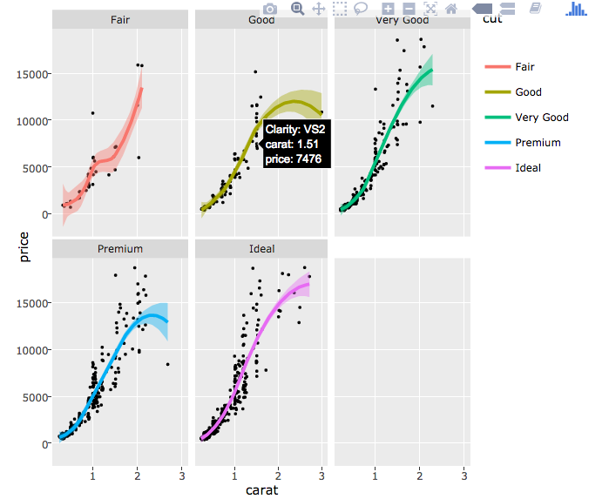
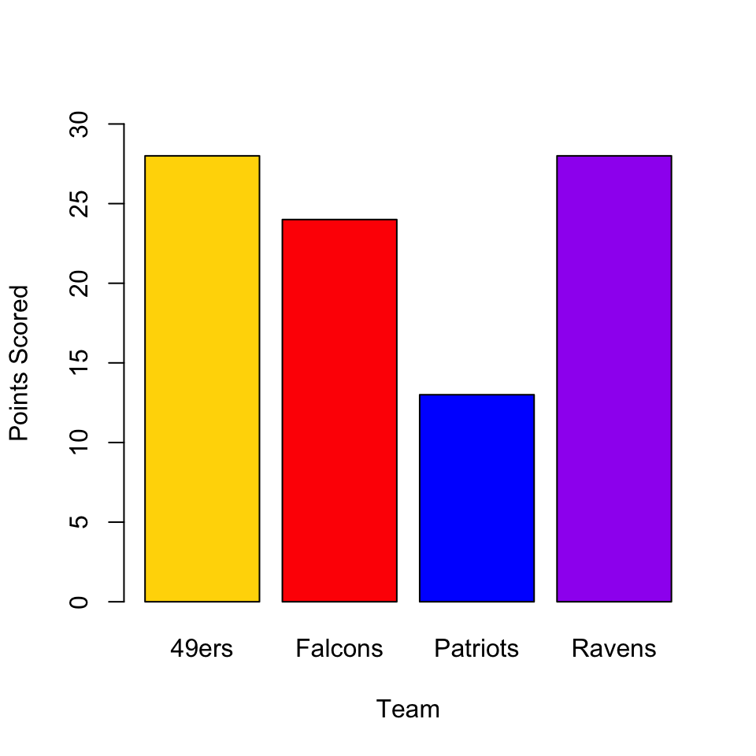
Visualizations
This Photo by Unknown Author is licensed under CC BY-SA-NC
This Photo by Unknown Author is licensed under CC BY
This Photo by Unknown Author is licensed under CC BY
This Photo by Unknown Author is licensed under CC BY-SA

Slide 11
Defaulting Parameters
Defaulting parameters
Main Account(MA)
Loan taken
age of network
Data Account(DA)
Frequency of recharge
Amount of recharge
Freq. of recharge
amount of recharge
number of loans
Daily amount spent from MA
Daily amount spent from DA
Total amount of loans
Average Payback time
Maximum amount of loan taken
Main account balance
No. of days till last recharge
No. of days till last recharge

Slide 12
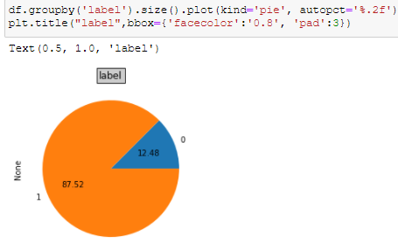
Class Imbalance (Target column)
More 1’s than 0’s in the dataset, target column is severely imbalanced.

Slide 13
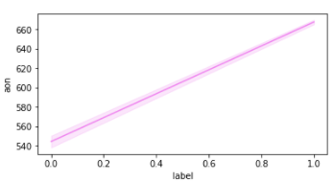
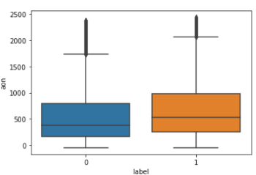
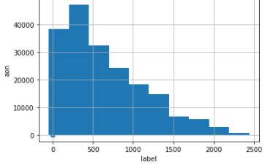
Age on Network
- Greater the age, lesser default rates.
- Defaulting takes place when median age is around 480days, maximum is 1700 days.
- Majority of the customers are below 1000 days old.

Slide 14

Any customer can recharge 2 accounts
Main
Data
For duration:
30 days or
90 days

Slide 15
Main Account
Main account(MA) (30 and 90 days)
number of times recharge done
Median of MA account bal. before recharge
Frequency of MA acc. recharged
Median of amount of recharges done in MA
Median of main account balance just before recharge at user level
Total amount of recharge
No. of days till last recharge

Slide 16
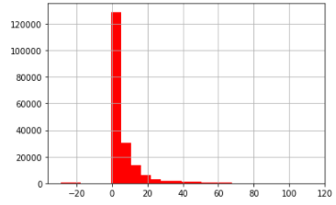
Number of days till last recharge of main account
Most of the main accounts were recharged 10 to 12 days before the sample was listed.

Slide 17
For the last 30 days

Slide 18
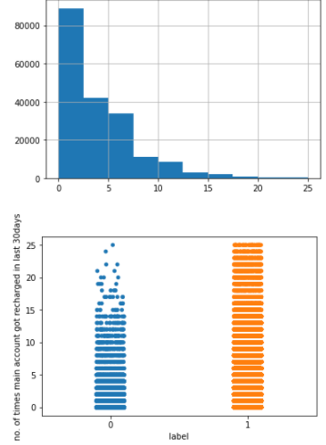
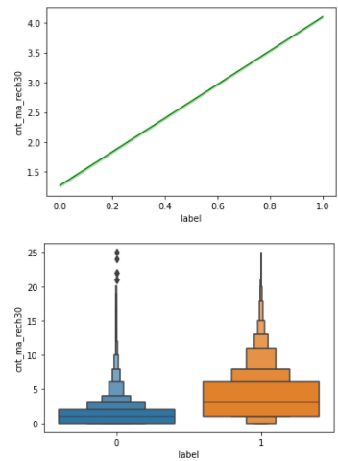
Number of times main account got recharged
Maximum number of recharges is between 1 and 4.
Defaulting is less for people with number of recharges above 20 per month

Slide 19
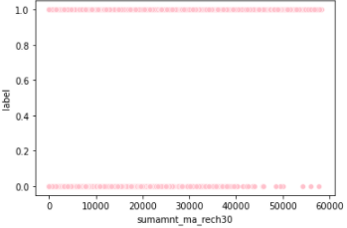
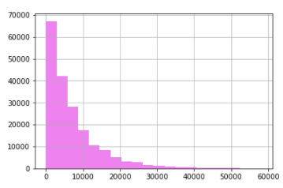
Total amount of recharge in main account (in IDR)
Maximum recharges were of the amount ranging between 0 to 10k.
Defaulting becomes less when the recharging amount crosses 45k IDR, meaning people with higher recharges were less likely to default on a micro loan

Slide 20
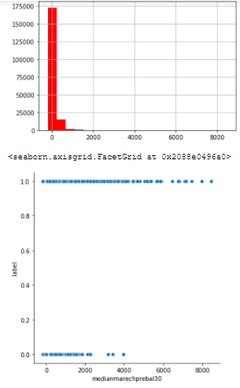
Median of main account balance just before recharge
Median of amount is between 0 and 100
Lesser chances to default if the median before recharge was above 2500.

Slide 21
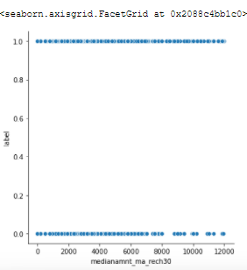
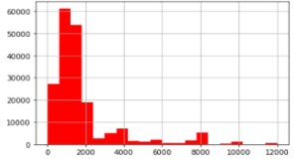
Median of amount of recharges done in main account at user level
Median ranges between 500 to 2200 IDR
Scatter plot tells us that the median of defaulters is constant till 8000 IDR after which it becomes inconsistent indicating chances of defaulting decreases.

Slide 22
For the Last 90 Days

Slide 23
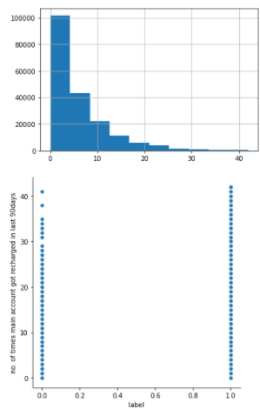
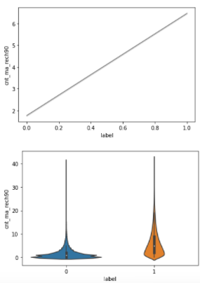
Number of times main account got recharged
Majority of the recharges were done below 5
Defaulters were recharging their account on average only twice in 90 days.
Defaulting rate decreases when recharging rate is above 30 times in 90 days

Slide 24
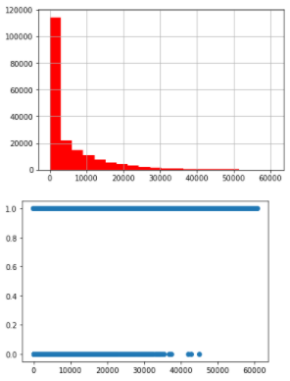
Daily amount spent from main account
Majority spent between 0 to 2500 daily
Defaulting reduces when daily amount spent exceeds 38000 IDR

Slide 25
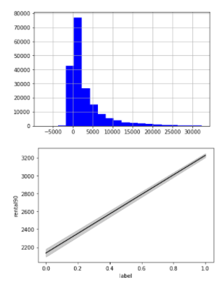
Average Main account balance
Defaulters had an account balance below 2600 and some had negative balances as well.
Non defaulters have average balance of at least 3000 in the last 90 days

Slide 26
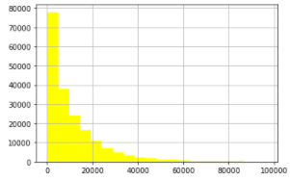
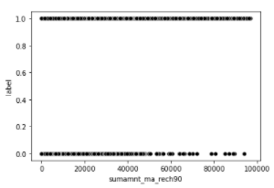
Total amount of recharge
Majority recharged their accounts with an amount close 10k IDR .
Defaulting diminishes after amount of 50000 IDR recharges done by customers in last 90 days

Slide 27
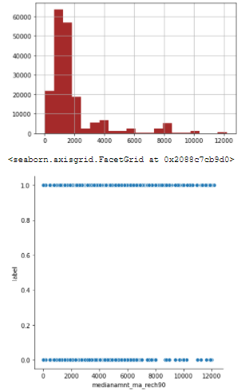
Median of amount of recharges done at user level

Slide 28
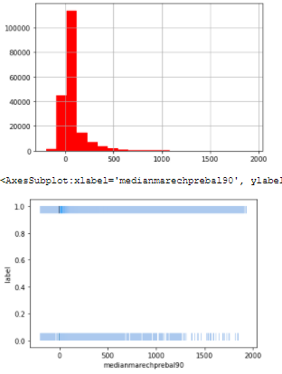
Median of main account balance just before recharge

Slide 29
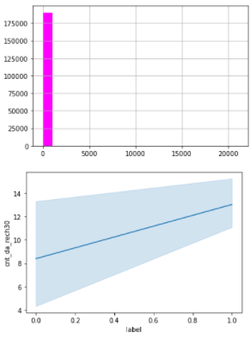
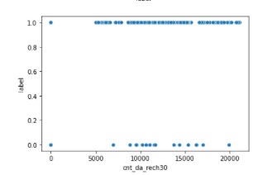
Number of times data account got recharged in last 30 days
Customers are defaulting between the recharge amount range of 7000 to 17,500 IDR
Customers recharging below 8 times in a month are prone to defaulting

Slide 30
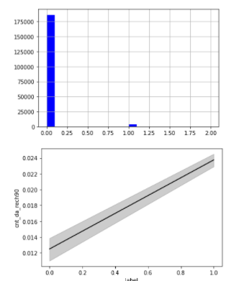
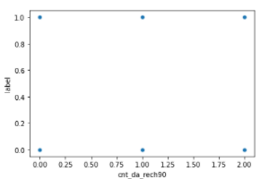
Number of times data account got recharged in last 90 days
Majority of the people had 0 recharges in the last 90 days
No impact on the label.

Slide 31
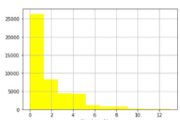
Number of loans taken by user in last 30 days
Majority have taken at loans between 0 and 2

Slide 32
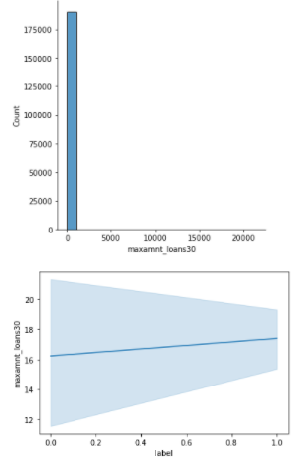
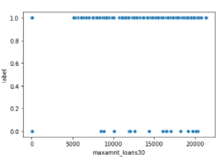
Maximum amount of loan taken in 30 days
Defaulting is high above when amount is greater than 16000 IDR
Only two amounts in loan – 5 and 10 which is why the histogram is centred at 0.

Slide 33
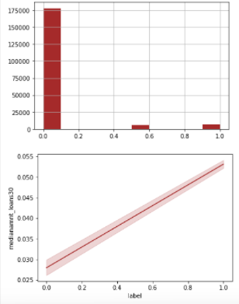
Median of amounts of loan taken by the user in last 30 days
Median is below 0.1
Median is almost half for defaulters when compared to non-defaulters.

Slide 34
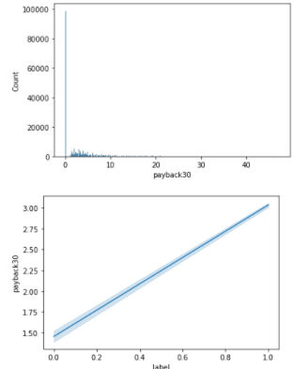
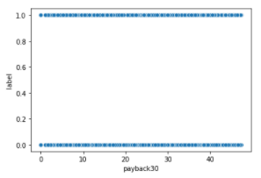
Average payback time in days over last 30 days
No impact on label
Mean Payback time is below 10 days
Majority(75%) returned their loans before 1 day

Slide 35
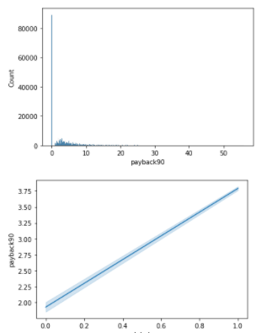
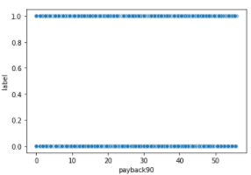
6.2 Average payback time in days over last 90 days
No impact on label
Most defaulters have a payback time of 2 days for 90 days loan.

Slide 36
Conclusion
This project dealt with helping the company understand how and what kind of factors is leading to customers defaulting on their micro loans. This can help them perform a root cause analysis on how to mitigate such factors and retain non defaulting customers.
This project is somewhat limited as the quality of data is not up to the mark and does not cover various facets such as less samples, data available for only one year, not much information about user information except a phone number.
With larger models’ cloud and large-scale data libraries such as Pandas can be used to create models and further expand the scope of the project to include various social classes of the population. Features can be added to express its users in different ways and help the company form strategies to market themselves to those sect of customers

Slide 37


